Slide 1
Section 4: The Periodic Table
Chapter 4: Atoms and Elements

Slide 2
Learning Goals
Identify metals, nonmetals, and metalloids.
Use the periodic table to classify elements by group.

Slide 3
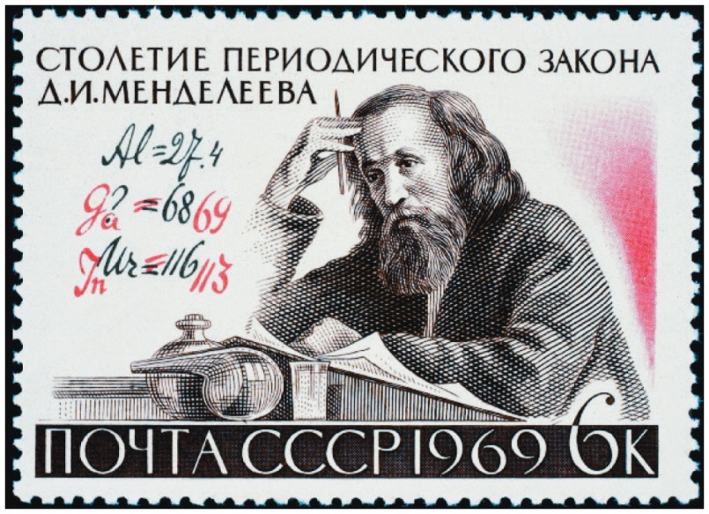
Periodic Table
Dmitri Mendeleev (1834-1907)
Russian chemistry professor
proposed from observation that when the elements are arranged in order of increasing relative mass, certain sets of properties recur periodically

Slide 4
Periodic Table
The color of each element represents its properties.
Notice the repeating pattern

Slide 5
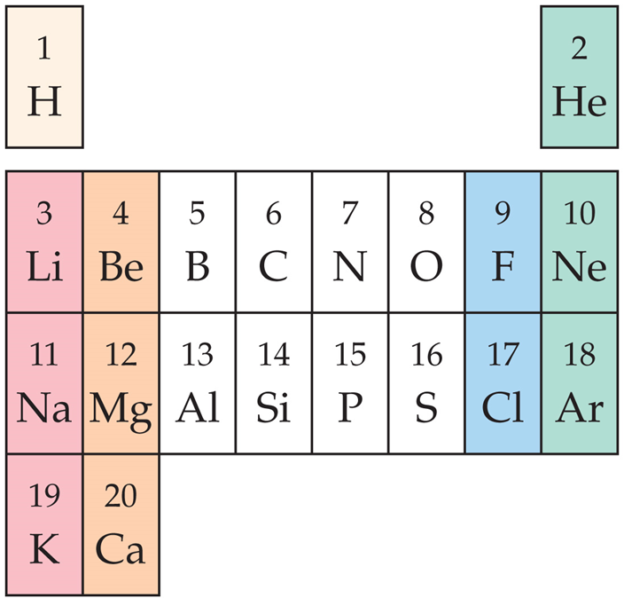
Periodic Table
We arrange them in rows so that similar properties align in the same vertical columns. This figure is similar to Mendeleev’s first periodic table.

Slide 6
Periodic Table
Mendeleev’s periodic law was based on observation.
Like all scientific laws, the periodic law summarized many observations but did not give the underlying reason for the observation
only theories do that!

Slide 7
Periodic Table
Group / Family: a vertical column in the periodic table.
Elements within groups have similar properties.
Period / Row: Horizontal rows on the periodic table.

Slide 8
Periodic Table
The elements in the periodic table can be broadly classified as metals, nonmetals, and metalloids.

Slide 9
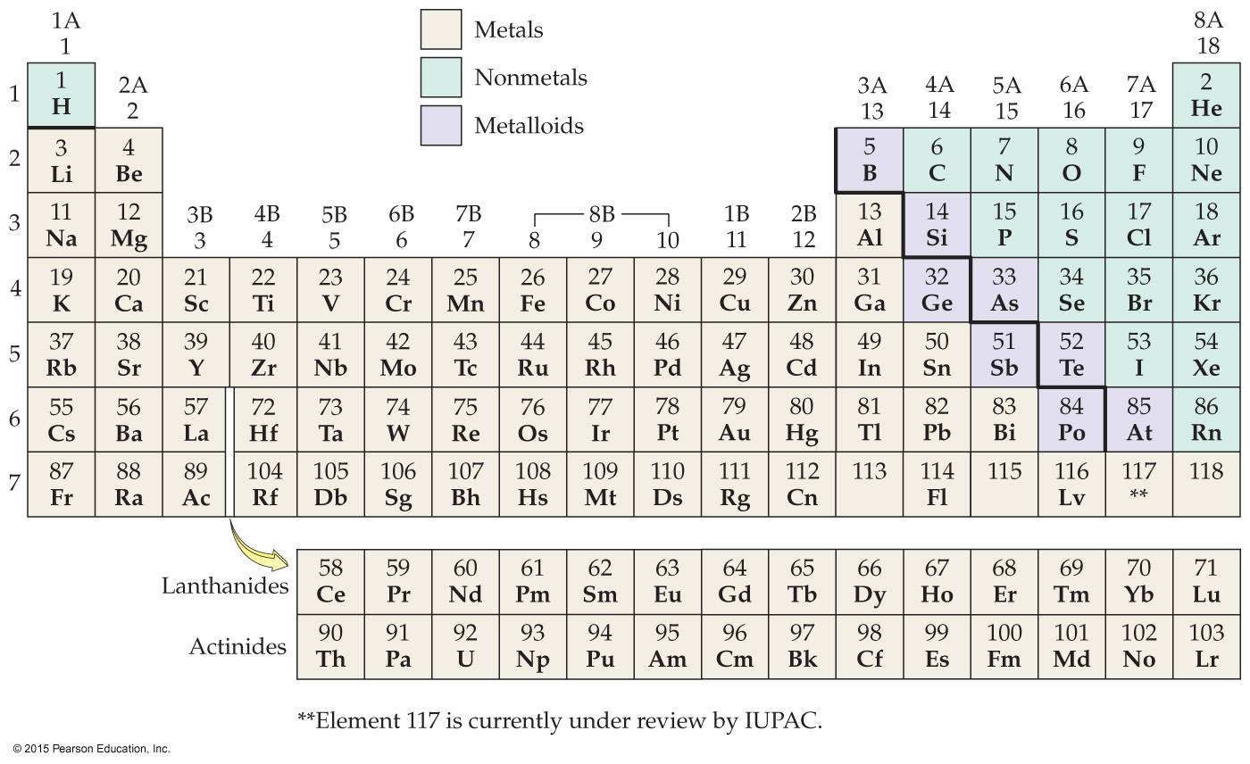

Slide 10
Metals
Metals occupy the left side of the periodic table and have similar properties.
good conductors of heat and electricity
can be pounded into flat sheets (malleability)
can be drawn into wires (ductility)
often shiny (lustrous)

Slide 11
Metals
tend to lose electrons when they undergo chemical changes
mostly solid at room temperature
Except → Mercury (Hg)

Slide 12
Nonmetals
Nonmetals occupy the upper right side of the periodic table.
The dividing line between metals and nonmetals is the zigzag diagonal line running from boron to astatine.
Nonmetals have more varied properties; some are dull, brittle solids at room temperature, while others are gases.
Br is a liquid

Slide 13
Nonmetals
As a whole, nonmetals tend to be poor conductors of heat and electricity.
Nonmetals tend to gain electrons when they undergo chemical changes.

Slide 14
Metalloids
Metalloids lie along the zigzag diagonal line dividing metals and nonmetals.
also called semimetals
display mixed properties

Slide 15
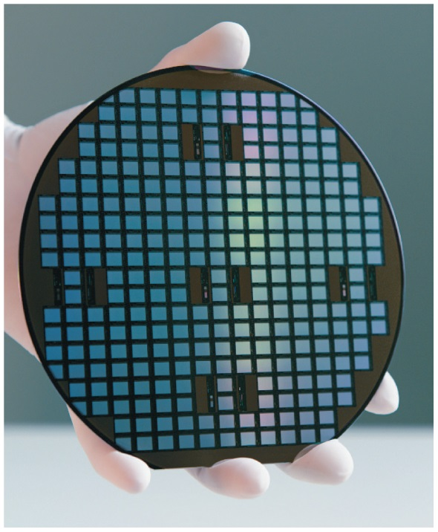
Metalloids
Metalloids are also called semiconductors because of their intermediate electrical conductivity, which can be changed and controlled.
This property makes semiconductors useful in the manufacture of electronic devices that are central to computers, cell phones, and other modern gadgets.

Slide 16
Metalloids
Not as malleable as metals
Not as brittle as nonmetals
Silicon, arsenic, and germanium are good examples of metalloids.

Slide 17
Practice
Classify each element as a metal, nonmetal, or metalloid.
Ba
Br
O
Te

Slide 18
Groups
In main group elements, properties can generally be predicted based on the element’s position.
In transition elements, properties tend to be less predictable based on the element’s position.

Slide 19
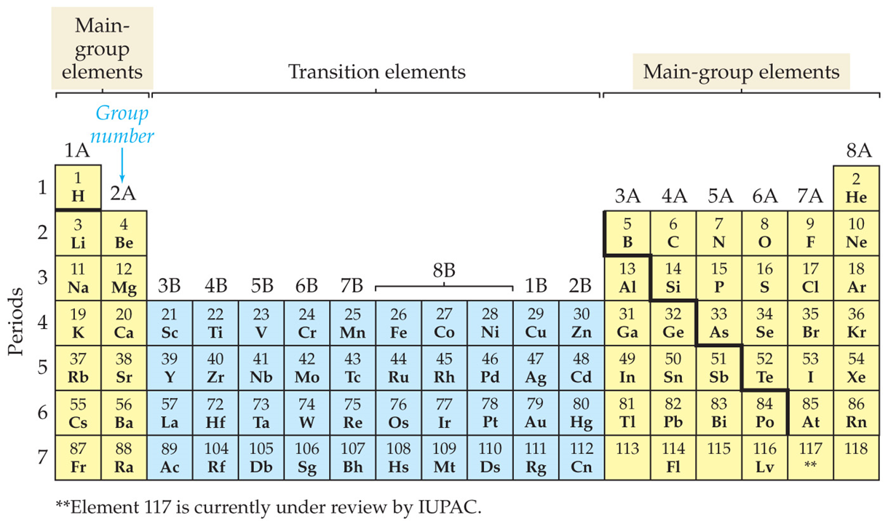

Slide 20
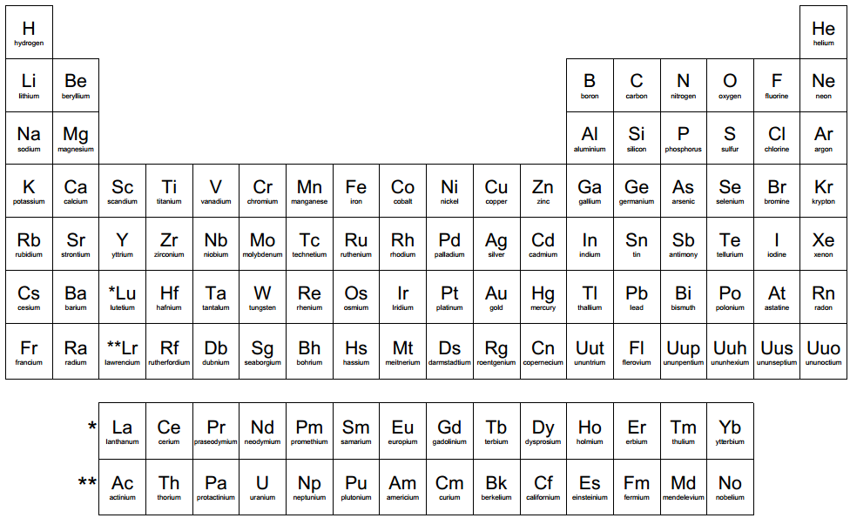

Slide 21
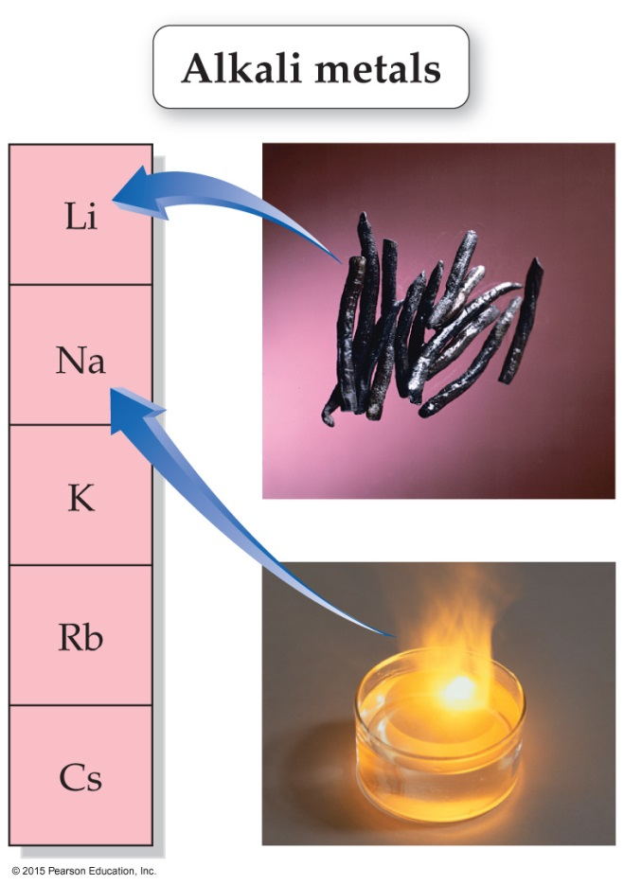
Alkali Metals – Group 1
The alkali metals include lithium, sodium, potassium, rubidium, and cesium.

Slide 22
Alkali Metals – Group 1
Shared Properties:
Silvery metallic appearance
Very soft
Low melting points compared to other metals
Very reactive – not found in nature as free metals

Slide 24
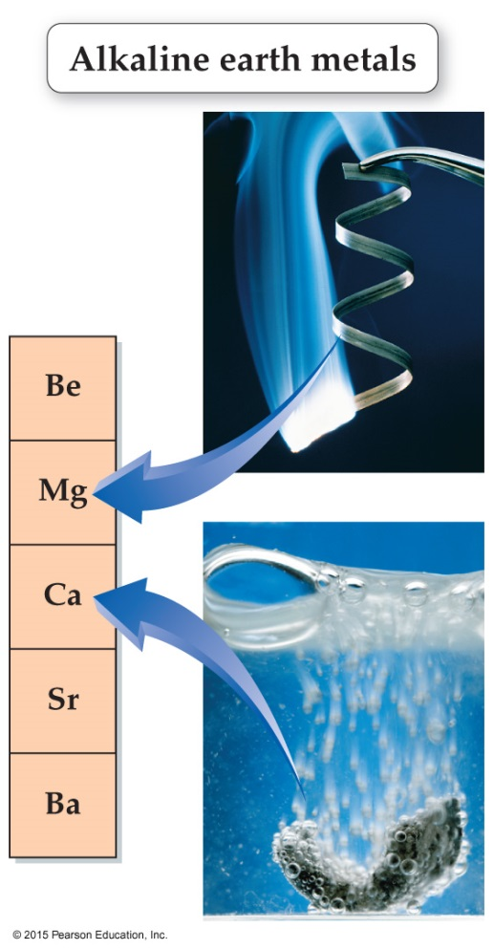
Alkaline Earth Metals – Group 2
The alkaline earth metals include beryllium, magnesium, calcium, strontium, and barium.

Slide 25
Alkaline Earth Metals – Group 2
Shared Properties:
Silvery-white, metallic appearance
Harder and denser than alkali metals, but still relatively soft
Higher melting and boiling points than alkali metals
Not as reactive as alkali metals

Slide 27
Transition Metals – Groups 3-12
Includes lanthanides and actinides

Slide 28
Transition Metals – Groups 3-12
Generally good conductors
High densities and high melting points
Properties are harder to predict than main group elements

Slide 29
Boron Group

Slide 30
Boron Group – Group 13
Mostly metals that have silvery white appearance
Boron is pure black and is a metalloid
Most are relatively lightweight and soft
Boron is extremely hard
Solids at room temperature
Higher boiling point than the alkaline earth metals

Slide 31
Boron Group
Carbon Group

Slide 32
Carbon Group – Group 14
Increase in metallic character as you go down the group
Carbon can be a black powder, a soft, slippery gray solid, a hard, transparent solid, or an orange red solid.
Silicon can be a brown powder or a shiny gray solid.
Germanium is a shiny gray white solid that breaks easily.

Slide 33
Carbon
Boron
Pnictogen

Slide 34
Pnictogen Group – Group 15
Increase in metallic character as you go down the group
Nitrogen is a colorless, odorless gas
Phosphorus can be found as a white, red, or black solid
Arsenic is a shiny gray solid that is brittle
Antimony is a shiny silver gray solid that is very brittle
Bismuth is a shiny gray solid that has pink cast to it. It is one of the least conductive metals.

Slide 35
Carbon
Chalcogen
Boron
Pnictogen

Slide 36
Chalcogen Group – Group 16
At room temp, oxygen is a clear, odorless gas, while the other elements are solids.
Sulfur is pale yellow, odorless, and brittle
Selenium can be a red powder or gray solid
Polonium has 27 known isotopes and all are radioactive

Slide 37
Carbon
Chalcogen
Boron
Pnictogen
Halogen

Slide 38
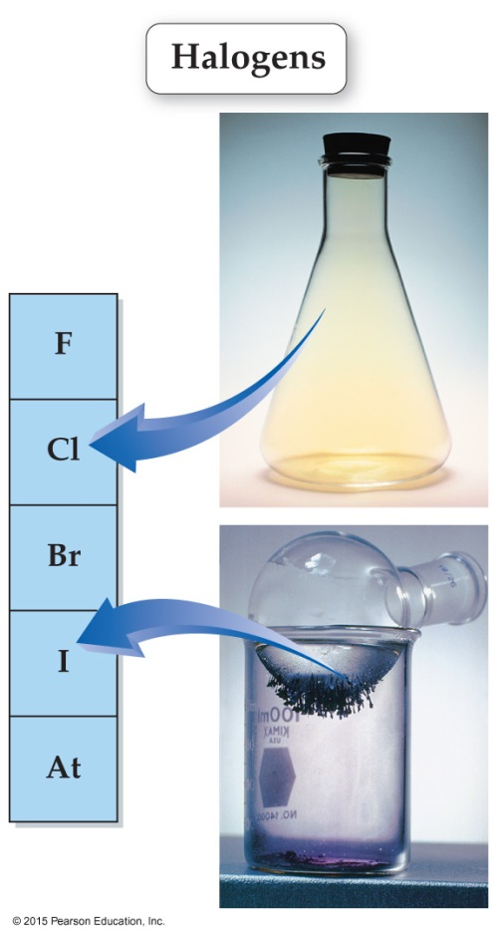
Halogens – Group 17
The halogens include fluorine, chlorine, bromine, iodine, and astatine.

Slide 39
Halogens – Group 17
At room temperature:
Fluorine is a pale yellow gas
Chlorine is a yellow green gas
Bromine is a red brown liquid
Iodine is a blue black solid that easily sublimes

Slide 40
Halogens – Group 17
Form diatomic molecules
React readily with alkali metals and alkaline earth metals
Fluorine is the most active of all of the elements

Slide 41
Noble Gases
Carbon
Chalcogen
Boron
Pnictogen
Halogen

Slide 42
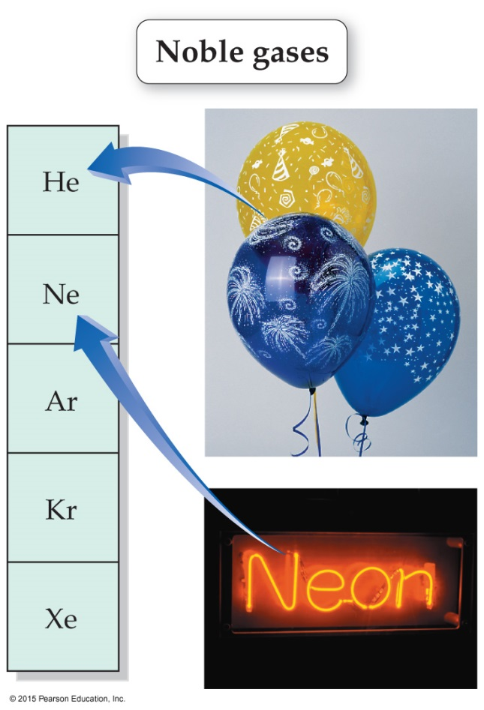
Noble Gases – Group 18
The noble gases include helium, neon, argon, krypton, and xenon.

Slide 43
Noble Gases – Group 18
Odorless, colorless gases
Lower boiling and melting points than other groups
Monoatomic
Mostly inert (don’t react)

Slide 44
Practice
To which group or family does each element belong?
Mg
N
K
Br

